Slide 1
Models for Understanding and Controlling Global Infectious Diseases HUMBIO 154D / HRP 204
Session 1
Jason Andrews
Jeremy Goldhaber-Fiebert
2020

Slide 2
Agenda
Intros/backgrounds
Course overview/structure
Motivating Example: COVID-19
Introduction of Topics and Background for Infectious Disease Modeling

Slide 3
Course personnel
Instructors:
Jason Andrews
Jeremy Goldhaber-Fiebert
Teaching Assistant:
Tess Ryckman

Slide 4



Putting names with faces and challenges of being totally online

Slide 5


Course Focus and Time-Critical, COVID-19 Work

Slide 6
Course themes
Infectious Diseases
Populations
Models
Outcomes
Uncertainty
Interventions

Slide 7
Learning goals (1)
Translate infectious disease epidemiology into a formal model
Understand how biological, epidemiological, and clinical data and theory can produce inputs to formal models and how such models also help us to understand the data
Interpret outputs from models in terms of impacts on incidence, prevalence, and severity and assess their robustness/uncertainty

Slide 8
Learning goals (2)
Develop familiarity with the dynamics of transmission of infectious diseases, including the roles of susceptibility, immunity, herd immunity, and pathogen characteristics like reproductive numbers and serial intervals
Explore how including realistic demography in infectious disease models has implications for epidemiologic outcomes and intervention effects

Slide 9
Learning goals (3)
Understand the conditions under which infectious diseases may die out, remain endemic, become epidemic in a particular population and the link to designing effective control strategies and health interventions
Evaluate critically how particular models represent common infectious disease treatment, control, and prevention policies and how these representations may influence findings of model-based analyses

Slide 10
Two courses in one
Undergraduate and graduate students
Undergraduates = HUMBIO 154D
Graduate students = HRP 204
Lectures and labs are for both groups
Additional graduate section for students enrolled in HRP 204
Thursdays, 5:15-6:15 pm, starting Week 2 (April 16) and on Tuesday for the last week of the course in June
Our experience is that courses that mix undergraduate and graduate students produce excellent discussions and learning
Notes:
Could mention policy/expectations for auditors here?

Slide 11
Large virtual course with auditors
We are delighted to be able to have a large class this year – currently ~60 people registered plus many auditors
Given the large size and the fact that the course is virtual and communications with students will be via email means that unfortunately
Taking questions during class time will need to be limited to enrolled students
Being unable to grade or provide feedback on labs or exams for auditors
Notes:
Could mention policy/expectations for auditors here?

Slide 12
Grades and Course Assignments
Grades
This year, per the university’s policy: All grading will be S/NS
Assignments
4 ungraded problem sets: 40% (for submission)
1 midterm problem set: 20%
Final exam: 40%
HRP 204 Graduate Section: Requirements above count for 80% of the graduate grade in their proportions, and the remaining 20% come from presentation and weekly participation in the section
Notes:
On this slide might be good to cover attendance policy (e.g. we’re flexible about attendance during lectures – will be recorded – but encourage it as much as possible. For graduate section, we are grading based on participation? But some absences still allowed?)

Slide 13
Attendance
Given the current situation, attendance for the main class sessions is not mandatory and the lectures/laboratory sessions in class will be recorded
For the graduate section, we strongly encourage attendance (understanding that the situation may present extenuating circumstances for some on some days). Each student will be responsible for presenting part of one paper on a given week, so on that week it is important to make every effort to attend and present. Further details coming very soon.
Notes:
On this slide might be good to cover attendance policy (e.g. we’re flexible about attendance during lectures – will be recorded – but encourage it as much as possible. For graduate section, we are grading based on participation? But some absences still allowed?)

Slide 14
Remote Learning
Lectures and R labs (both on Zoom) will be recorded and posted to Canvas
Zoom etiquette
Please attend lectures (live) when possible
Video encouraged (not required), mute on please
We will use the chat feature for students to ask questions and pause periodically to answer them
Notes:
Adding this slide because I’ve gotten lots of questions about this – please feel free to add more

Slide 15
Textbook/software
Keeling MJ, Rohani P. Modeling Infectious Diseases in Humans and Animals.
Additional readings of journal articles that are all available through Stanford library and/or the course website
Graduate students in HRP 204: additional list of readings
NOTE: Readings may be modified during the quarter given the changing conditions and teaching by Zoom
Labs are in the R programming language (suggest students download R Studio; we will be giving appropriate tutorials and support specifically adapted to the distance learning situation this year)

Slide 16
Review/Catch-up Materials
Course will draw upon prior knowledge of mathematics, infectious diseases, epidemiology and statistics
We have posted recommended readings and references in these four areas
If you have not completed the course perquisites, or it has been some time, would recommend reviewing these materials in the first couple weeks
May also be useful as reference during course

Slide 17
Policies
Course conforms to all university policies
Students who may need an academic accommodation based on the impact of a disability must initiate the request with the Student Disability Resource Center (SDRC) within the Office of Accessible Education (OAE).
See syllabus for further course policies details

Slide 18
Motivating EXAMPLE

Slide 19
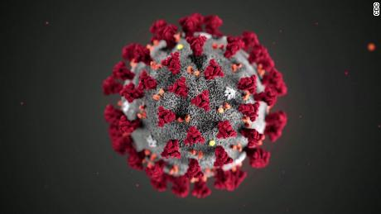
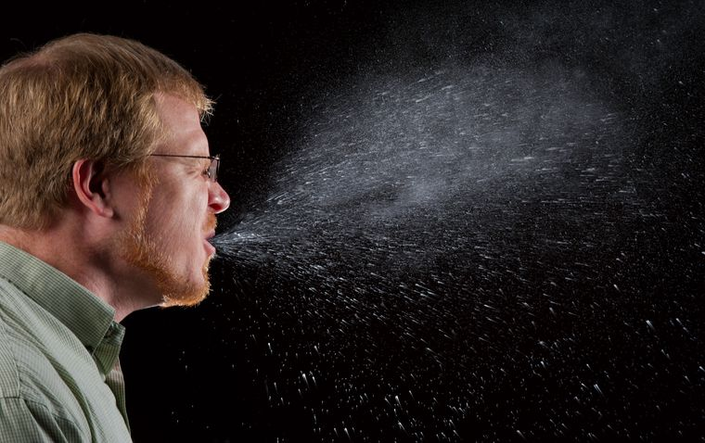
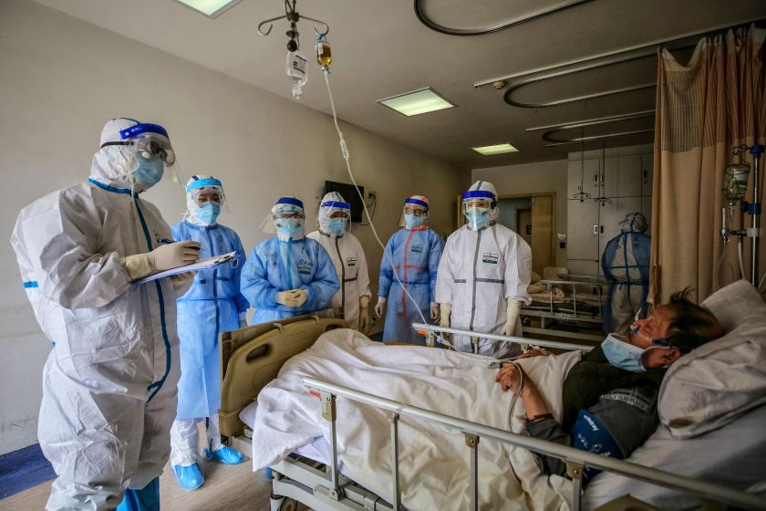

COVID-19: Perspectives

Slide 20
Coronavirus Epidemiology
Highly transmissible
~80% of cases mild, some totally asymptomatic
15-20% severe, mortality uncertain but substantial
Transmission occurs from both asymptomatic and symptomatic people
Transmission occurs both by droplets (sneezing) and aerosol (tiny suspended droplets that can hang in the air)

Slide 21

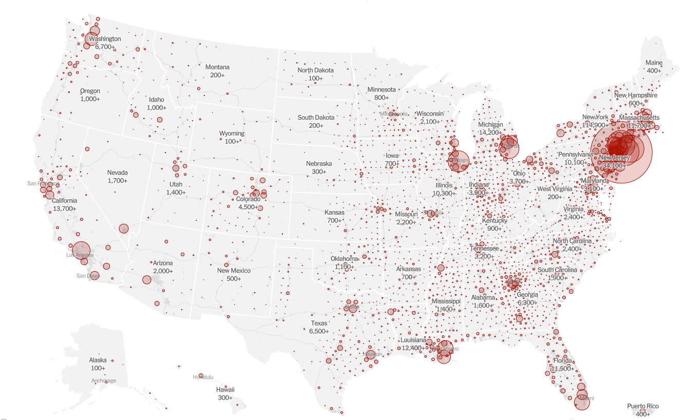

Slide 22
The Initial Path of an Epidemic
Prevalent Infections
Time

Slide 23
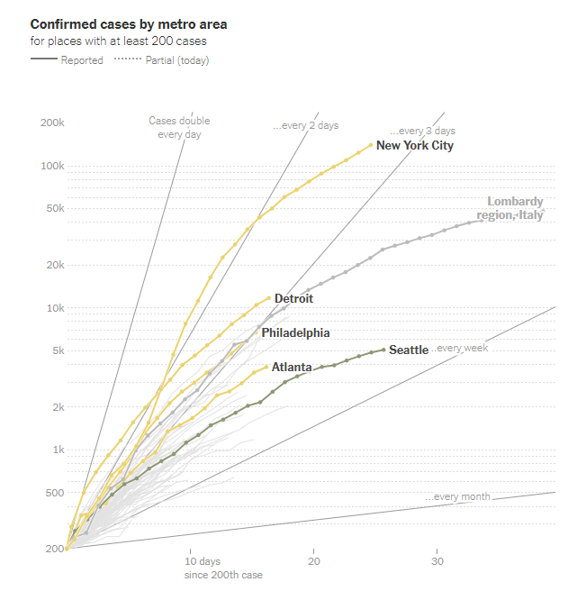

Slide 24
Social (Physical) Distancing
Tool to mitigate an infectious disease epidemic
Two main goals
Reduce total number of infections
Slow spread of infection
Slowing critical: enable people and systems to prepare
Slowing critical: prevent the health care system from being overwhelmed
1 infection/day for 14 days better than 14 infections in 1 day

Slide 25
The Initial Path of an Epidemic
Prevalent Infections
Time

Slide 26
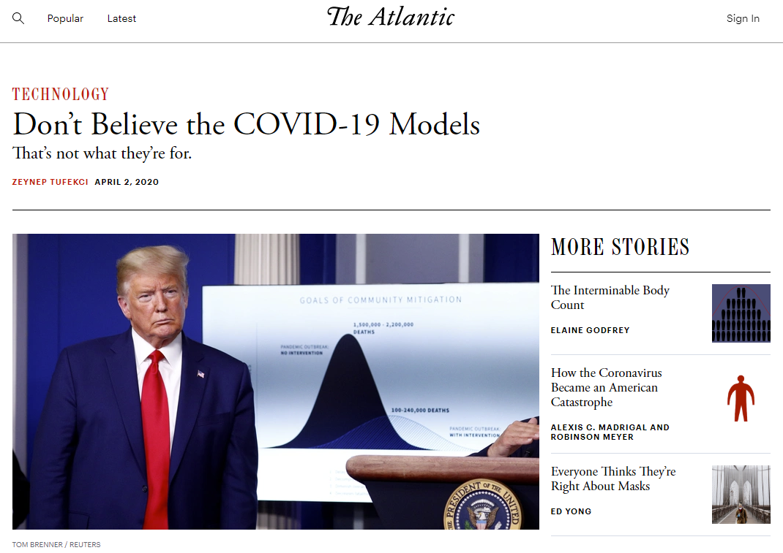
“So if epidemiological models don’t give us certainty—and asking them to do so would be a big mistake—what good are they? Epidemiology gives us something more important: agency to identify and calibrate our actions with the goal of shaping our future. We can do this by pruning catastrophic branches of a tree of possibilities that lies before us.”

Slide 27
“All models are wrong; but some models are useful”
-- George Box and Norman Draper, 1987

Slide 28
Introductory topics and background

Slide 29
Infectious Disease
A disease is infectious when it is caused by a pathogenic microorganism that can be spread (transmitted), directly or indirectly, from one person to another
Examples include tuberculosis, measles, COVID-19
The primary risk factor for infectious disease is contact with an infectious source (e.g., an infected person or contaminated water source)

Slide 30
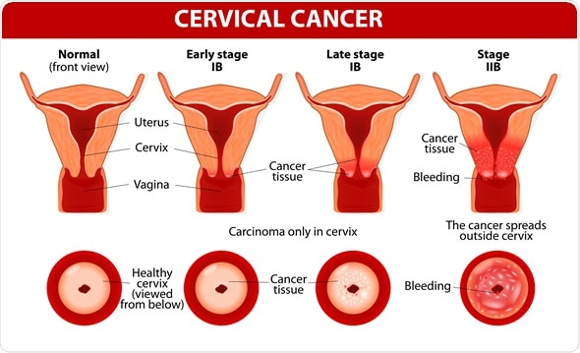
Infectious Disease
While we have focused thus far on infection and transmission, we should remember that infections can cause disease – disruptions to the body’s normal functioning
Human papillomavirus infections can cause cellular changes leading to cervical cancer

Slide 31
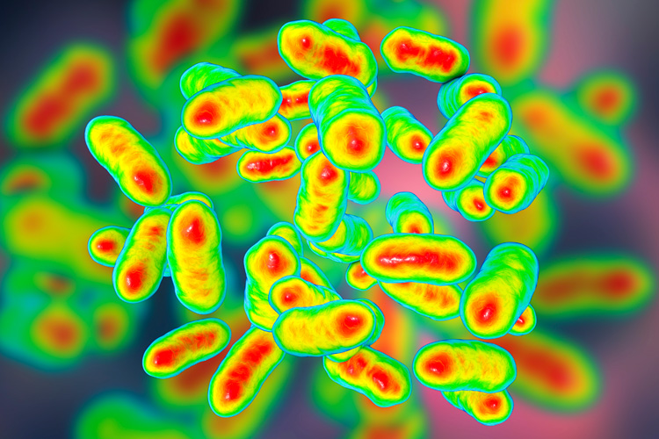
Types of Infectious Pathogens
Micro: Bacteria, Virus, Protozoa, Prions, Fungi
Macro: Helminths
Fascinating biological differences, but for our course, we are interested in their particular:
Transmission characteristics
Duration and severity of infection and disease
Ability to provoke immune responses
Available interventions like vaccines
Ability to adapt/evolve due to selection

Slide 32
Susceptible, Infectious, Recovered (SIR)
We turn our attention from pathogens to individual people residing in a population
To represent many kinds of infectious diseases in a population, we can think of people as being in 1 of 3 states:
Susceptible: Not infected and not immune to infection
Infectious: Infected and able to transmit to others
Recovered: Not infected and immune to infection

Slide 33
Variants / Extensions to the SIR Classification
How would you think about a disease like gonorrhea that does not produce long-term immunity? What states do you need?
Throughout the course we will consider a variety of extensions to this basic framework which can capture many types of infections in many different types of populations

Slide 34
Pathogen Transmissibility (1)
One can characterize how easily and quickly a pathogen is transmitted using a concept known as the basic reproductive number (R0)
R0 defines the number of secondary infections an infectious individual will produce on average in an otherwise entirely susceptible population
Measles’ R0 is estimated as 17 in mid-1900s UK

Slide 35
Pathogen Transmissibility (2)
While R0 is sometimes conceived of as a characteristic of a pathogen it is actually the characteristic of a pathogen and a given population
For example, Keeling and Rohani report HIV’s R0 for MSMs in the UK as 4 and for female CSWs in Kenya as 11. Why do you think that is?

Slide 36
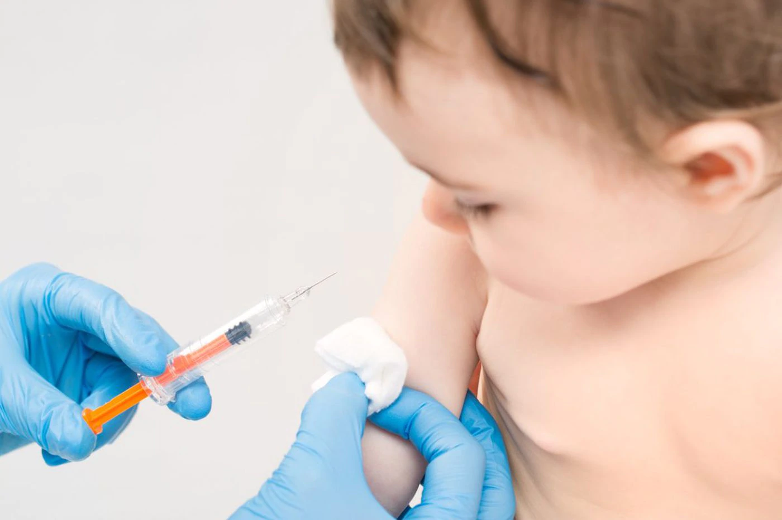
Control Measures (1)
Vaccination
Reduces the number of susceptible people to reduce rate of epidemic growth or ideally make it impossible for an epidemic to take hold
Important to remember that vaccination does not provoke sufficient immune response in all individuals – not all vaccinated individuals are immunized

Slide 37
Control Measures (2)
Quarantine and isolation
Reduce the number of infectious people circulating in the population
Isolation: separation of infectious individuals often identified via symptoms
Quarantine: separation of people who may have been exposed to infection for sufficient duration to determine whether they are infected/infectious
Generally less effective if implementation delayed
Quarantine can have high social costs

Slide 38
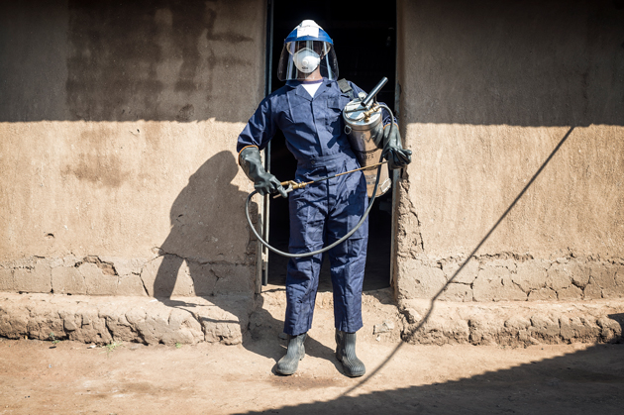
Control Measures (3)
Other interventions
Pharmaceutical interventions which reduce infectiousness or limit duration of infectiousness
Vector control like mosquito spraying to limit infectious contacts

Slide 39
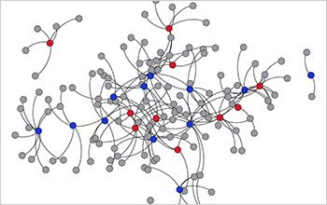
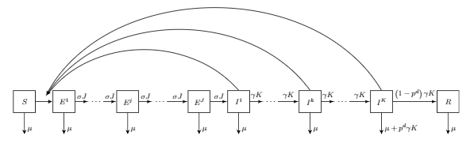
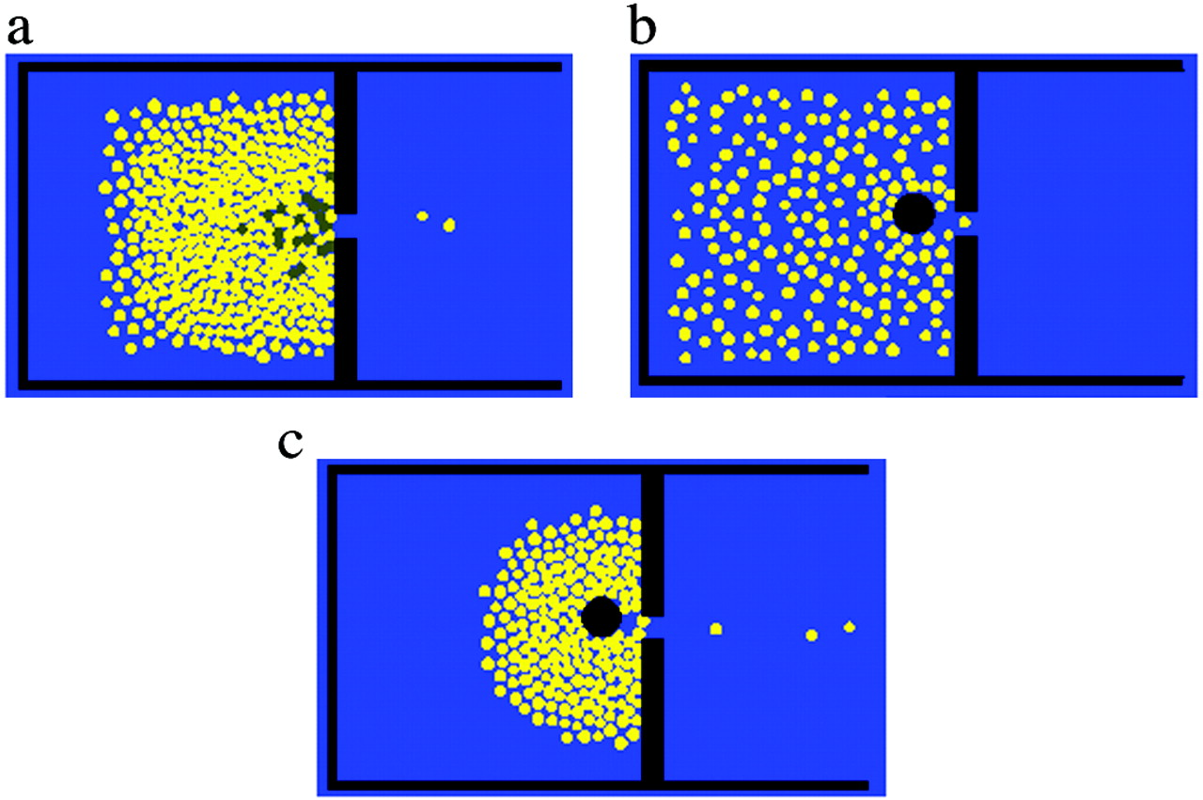
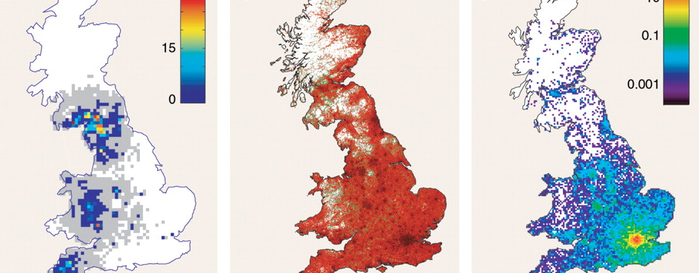
Types of Models (1)
Notes:
compartmental vs individual, static vs dynamic, deterministic vs stochastic, spatial and network structures,

Slide 40
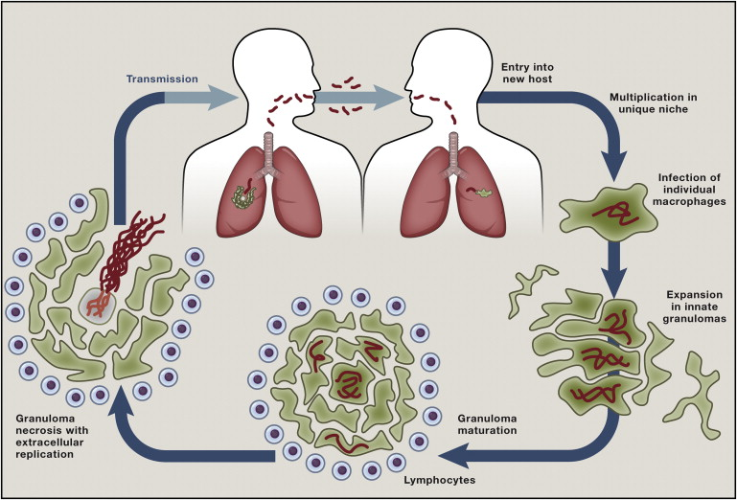
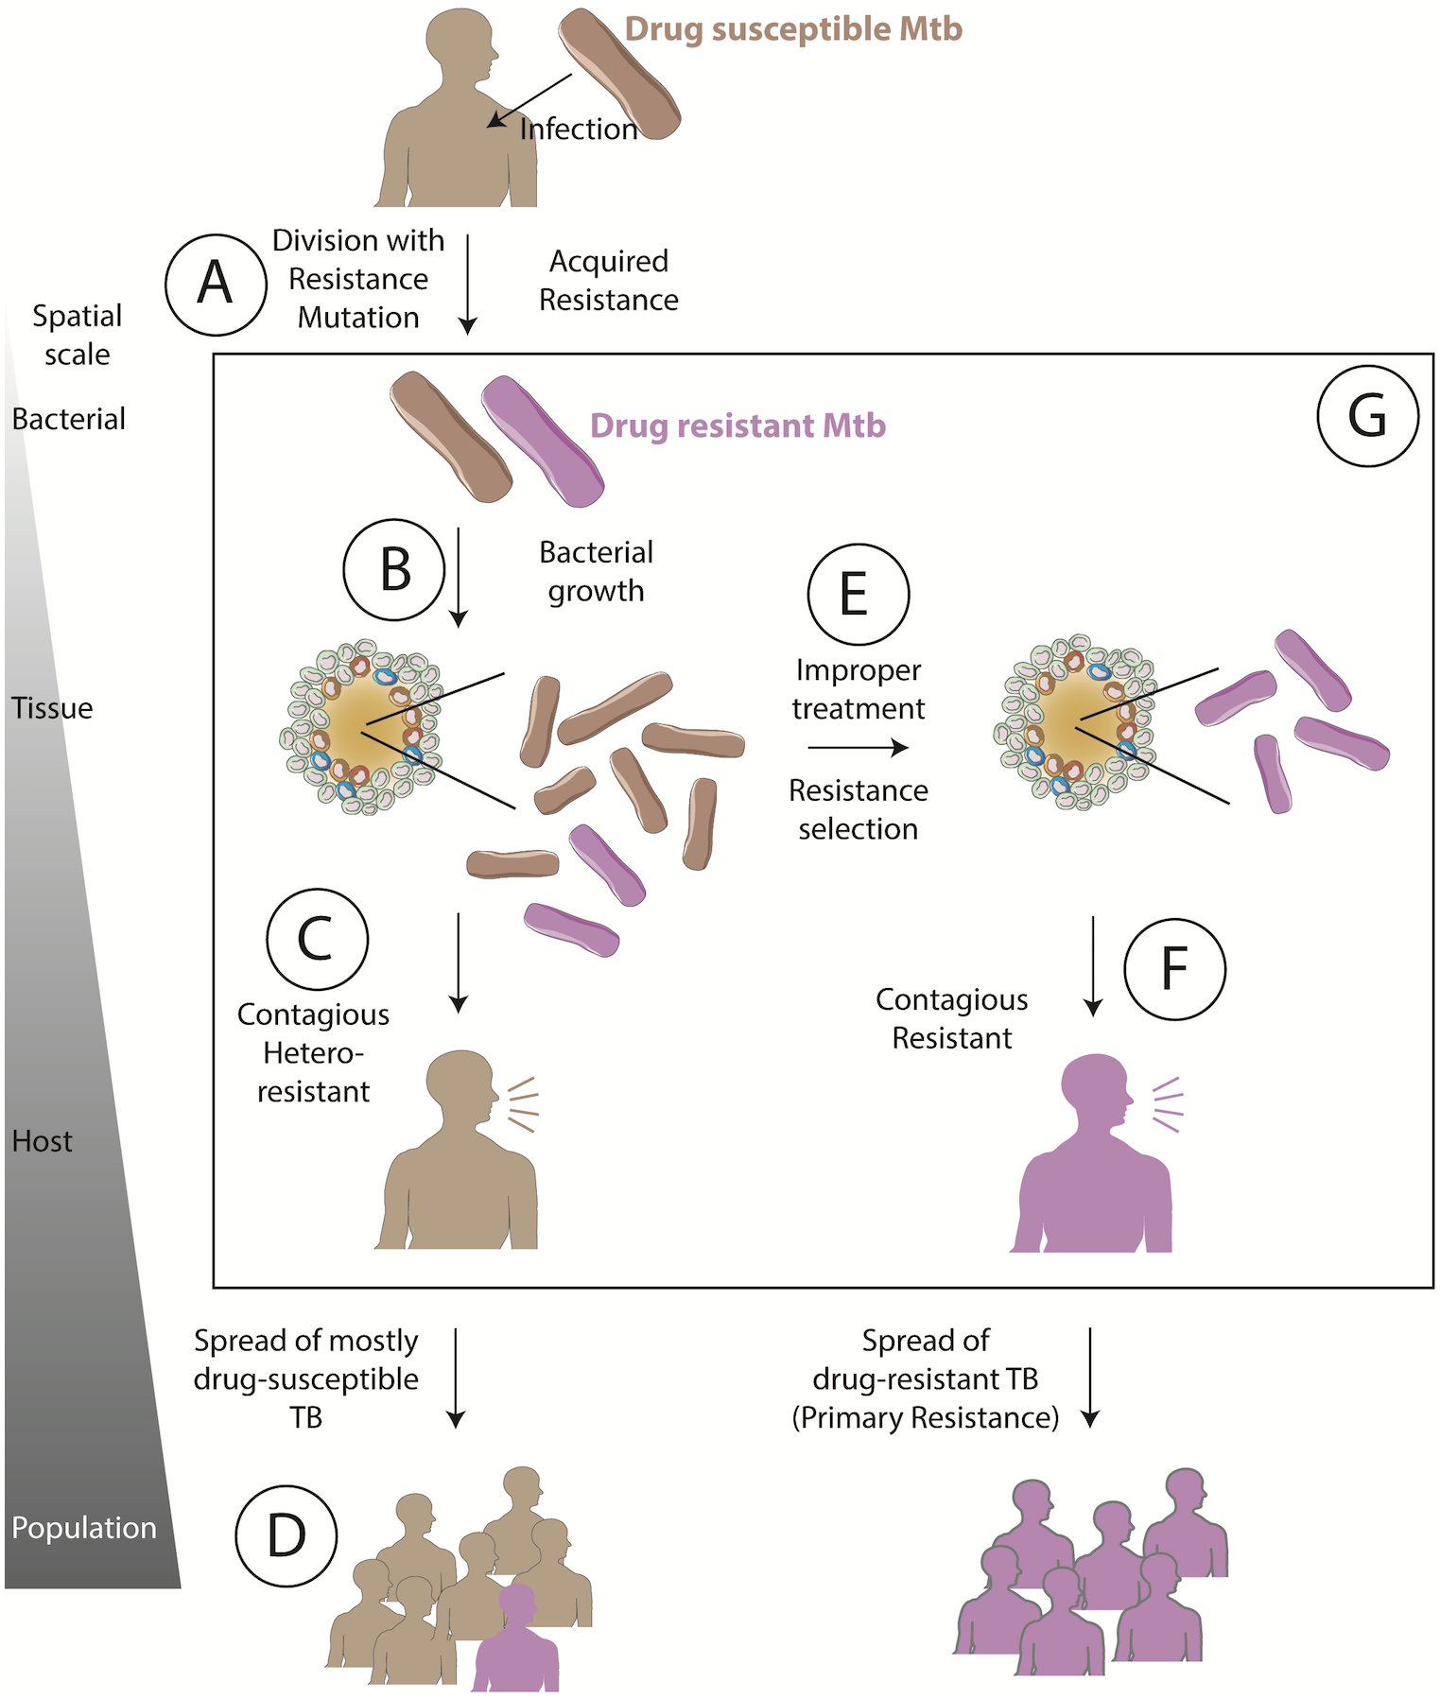
Types of Models (2)
Notes:
human populations vs within host, etc

Slide 41
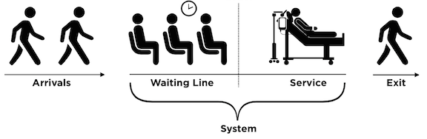
Mathematical Models (1)
Representation of how objects in a system interact and behave
Predict the population-level dynamics of an infectious disease from individual-level knowledge of epidemiological factors, extrapolate long-term behavior from early dynamics, and project the effects of control measures

Slide 42
Mathematical Models (2)
Choosing the right type/complexity of model depends on being useful for the question posed
Choosing involves balancing between advantages and disadvantages in terms of accuracy, transparency, and flexibility

Slide 43
Mathematical Models (3)
Accuracy: Ability to faithfully represent real-world data and all its heterogeneities and particularities (push to complexity)
Transparency: Ability to be understood and to understand why the model behaves as it does
Flexibility: Mechanistic models vs. black box time-series prediction (machine learning/neural nets)

Slide 44
Uses of infectious disease models (1)
Main uses of models include prediction and understanding
Notes:
“Understanding” bullet probably needs some edits.

Slide 45
Uses of infectious disease models (2)
To forecast the burden of a disease (cases, deaths, antimicrobial resistance)
Ex. Early Covid-19 models
To project the impact of interventions against infectious diseases
Ex. What would be the impact of shelter-in-place against COVID-19? How would vaccines given to different age groups affect overall incidence?

Slide 46
Uses of infectious disease models (3)
Understand biological and epidemiological phenomena
Ex. How does HIV have such a long incubation period? (Lecture 12)
Estimate important biological, medical or epidemiological parameters
Ex. What is the duration of immunity following cholera? What is the true infection fatality rate of COVID-19?

Slide 47
THE COURSE WILL Delve DEEPLY INTO THESE AND OTHER TOPICS

Slide 48
Course Roadmap
First Models
SIR models with demography
Reproductive Number, Thresholds, Equilibria
Lab: Dynamic Models in R
Heterogeneous mixing and temporal modeling
Emerging infections: takeoff, growth, extinction
Lab: Emerging infections
Vectors, zoonoses, & environmental transmission
Stochastic dynamics
Spatial models, networks
Interventions and sensitivity analyses
Lab: Interventions and sensitivity analyses
Competition and evolutionary models
Within host evolution
Lab on Parameterization, calibration, and uncertainty
Health policy and economic evaluation models
Uses and abuses of models

Slide 49
Important Announcements
Install and familiarize yourself with R and RStudio (see syllabus)
Graduate section:
5:15-6:15 pm on Thursdays (Zoom), starts Week 2 (April 16)
Week 1 reading (Blower et al, announced on Canvas) has been pushed to Week 2
See upcoming Canvas announcement from Tess with details on expectations and to sign up for a presentation slot
TA Office Hours: 3:30-5:30 pm on Wednesdays (Zoom)
For those less familiar with course background: supplementary readings on Canvas
Please direct initial email questions to Tess

